Slide 1
From Grammar to Geography:
A Computational Analysis of Language Tool Ads Across Countries
By Yijia Bai, Chenyun Wang
Notes:
We are going to use ads data from google search, to analyze the advertising strategies of the most popular language tools before the ai era.

Slide 2
Contents
Motivation
Data Collection
Image Text Extraction
Semantic Alignment Analysis
Visual Style Clustering of Ad Images
Cross-Country Variation in Semantic Alignment
Topic Modeling: What Do Ads Actually Say?
Notes:
Our research process, from data extraction, preprocessing to analysis on different aspect. We are going to first conduct a comparison between the texts used as a line of abstract, and the language marketing webpages of those tools

Slide 3
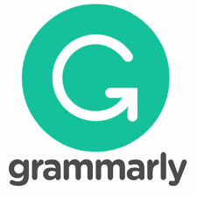

Part 1 Motivation
What is your favorite translation tool before genAI?
DeepL was the most accurate translation tool.
What are their advertising strategies now?
Geographically
Semantically
Topics
Notes:
Before the rise of generative AI, language tools like Grammarly and DeepL are most commonly used. Grammarly were used writing enhancement, and deepl was for high quality translation. How do they advertise themselves today?

Slide 4
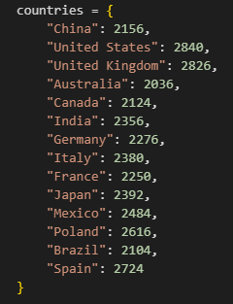
Part 2 Data Collection
Through Serp Api Google Search
Google search has a limitation of 100 returns each time
We divided our search into 14 countries, 3 format of advertisements. Theoretically, we can get 14*3*2*100=8400 data at most.
(5388, 15)
formats = ["text", "image", "video"]
Columns: advertiser information, ads information (id, format, detailed link, image url, image size, total days shown, start/end date, country)

Slide 5
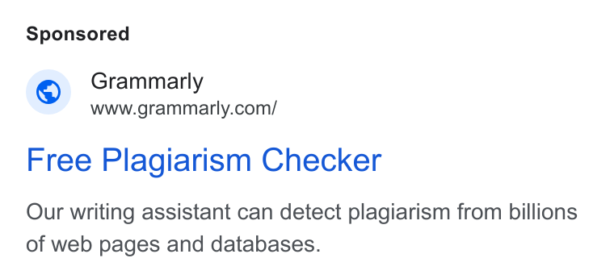
Part 3 Image Text Extraction
Text extracted from link: PIL, BytesIO and OCR
free plagiarism checker our writing assistant can detect plagiarism from billions of web pages and databases
+
www.grammarly.com/
Notes:
Optical Character Recognition

Slide 6
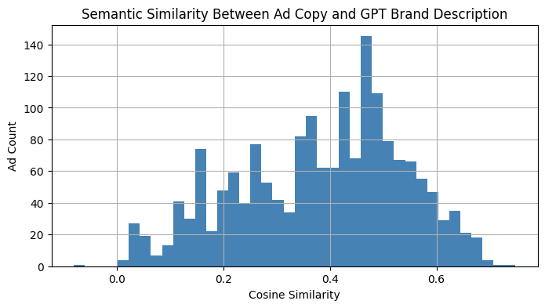
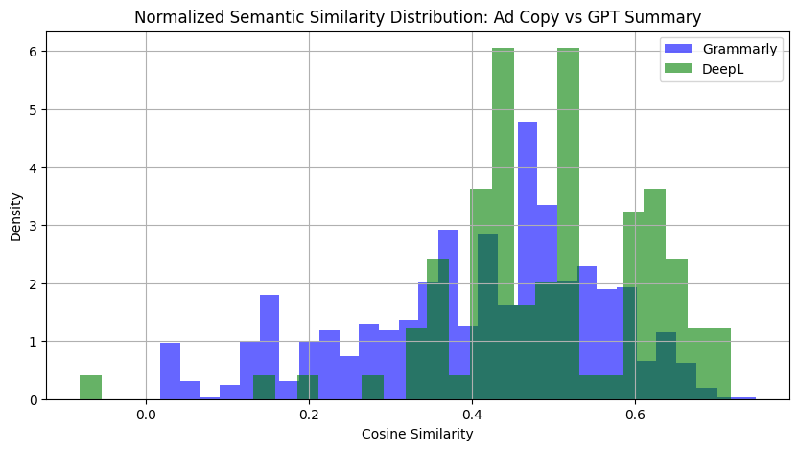
Part 4 Semantic Alignment Analysis
GPT summaries generated for both brands
OCR used to extract and clean ad text
Sentence-transformer used for semantic similarity
The majority of ads fall within the 0.3 to 0.5 range → partial alignment.
Grammarly: wide range, diverse strategy
DeepL: high consistency, brand coherence

Slide 7
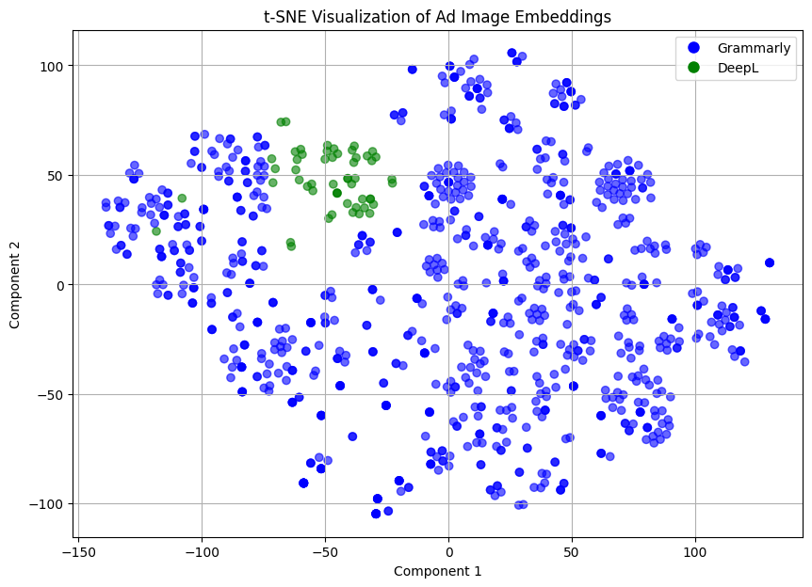
Part 5 Visual Style Clustering of Ad Images
Grammarly shows dispersed clusters → diverse visuals
DeepL is tightly clustered → consistent style
CLIP used to extract image features
t-SNE reveals design strategies

Slide 8
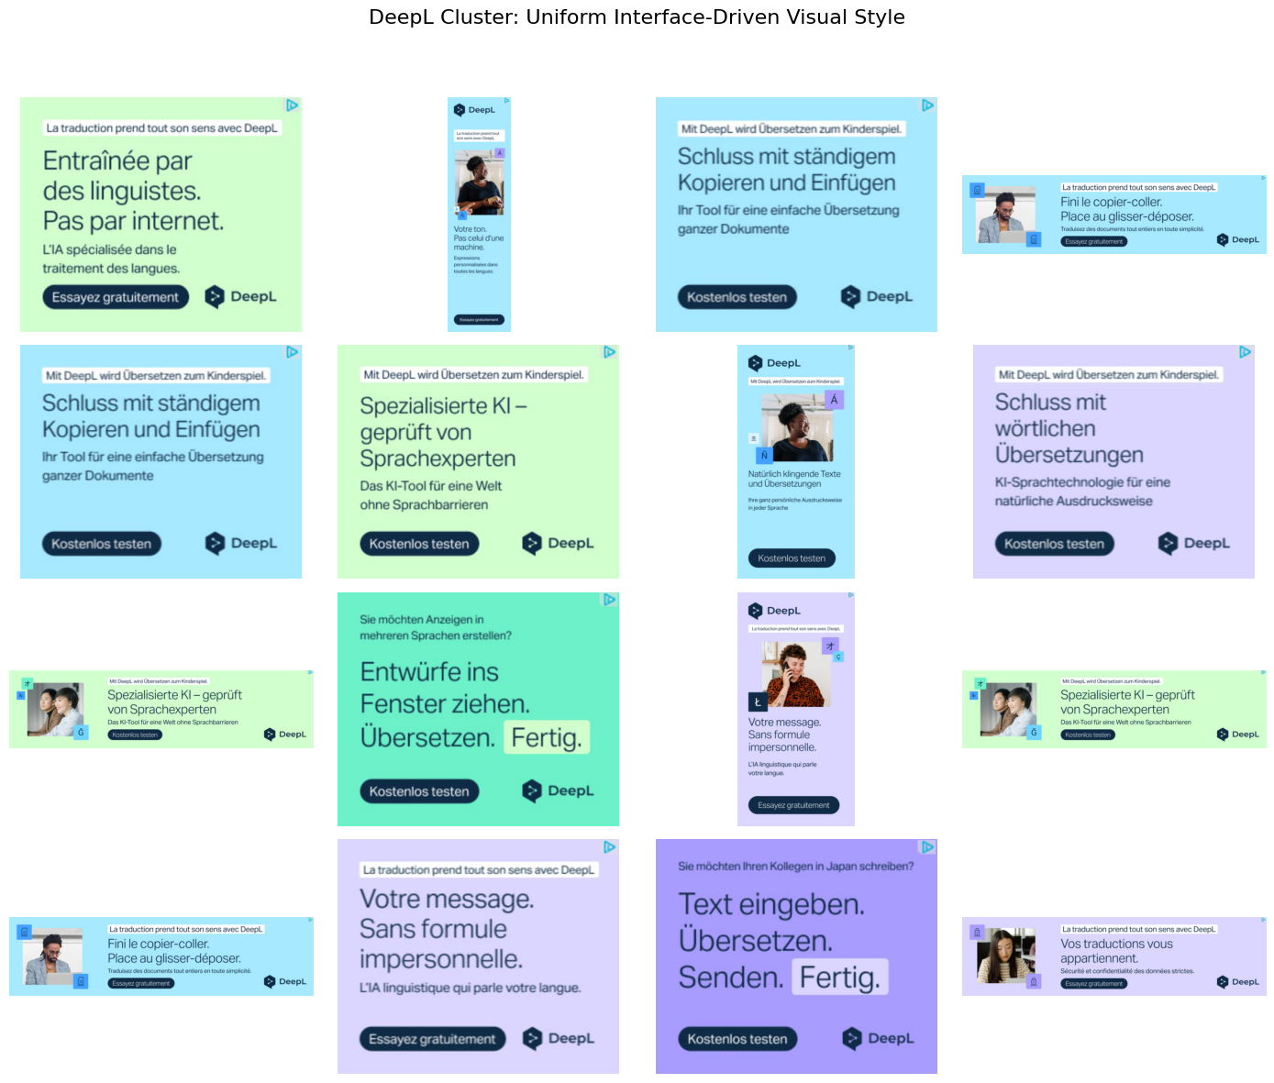
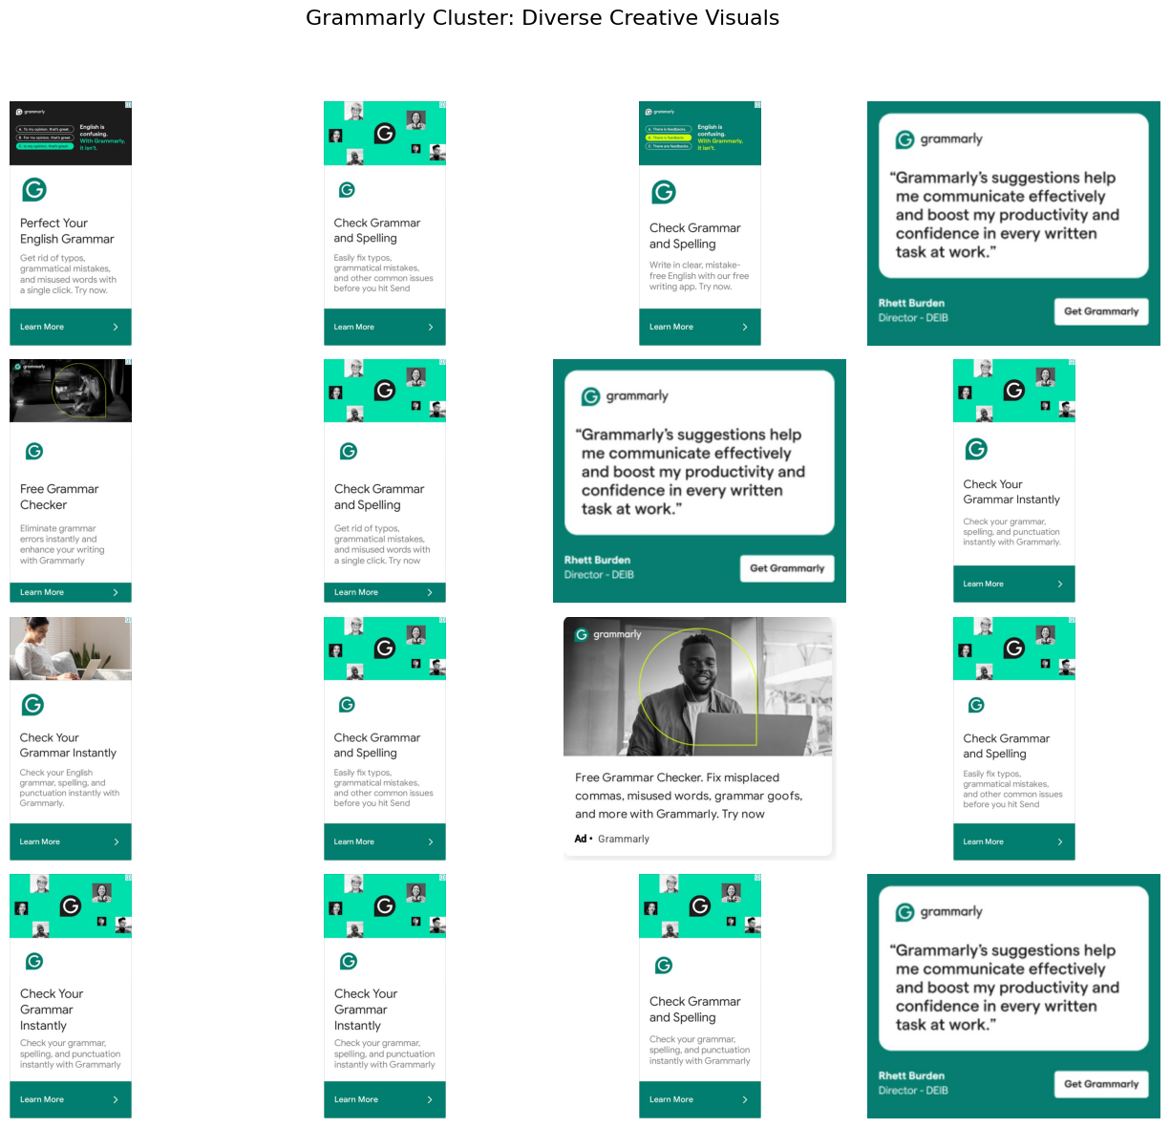
DeepL: uniform, product-focused visuals
Grammarly: diverse, audience-tailored designs
Visual consistency mirrors semantic alignment patterns.

Slide 9
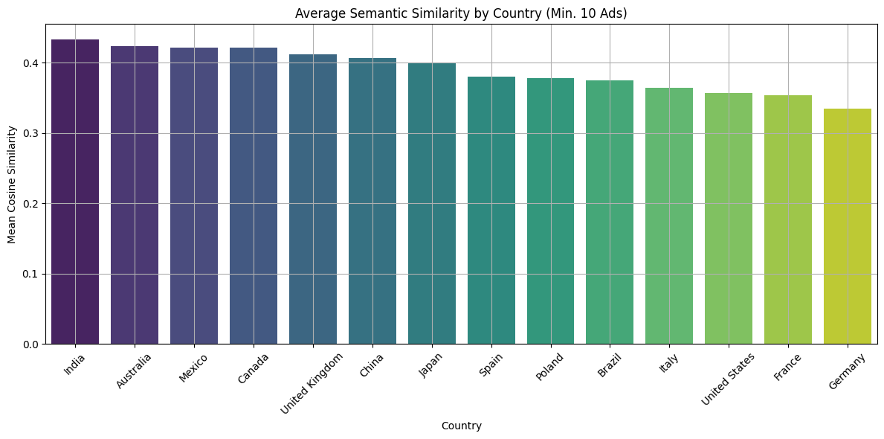
Part 6 Cross-Country Variation in Semantic Alignment
Overall Country-Level Similarity

Slide 10
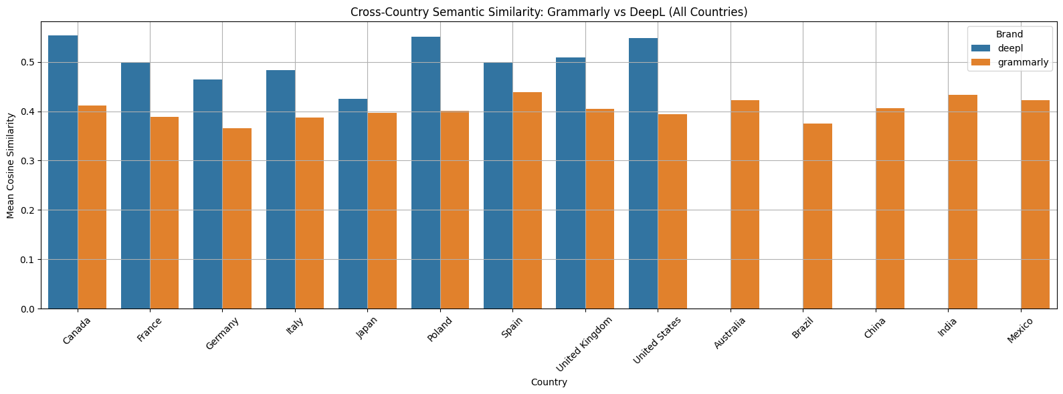
DeepL: consistent, standardized global messaging
Grammarly: adaptive, market-specific strategy
Algorithmic platforms allow both consistency and localization.
Brands respond to regional contexts in different ways, shaping the semantics of digital ads.
Brand by Country Comparison

Slide 11
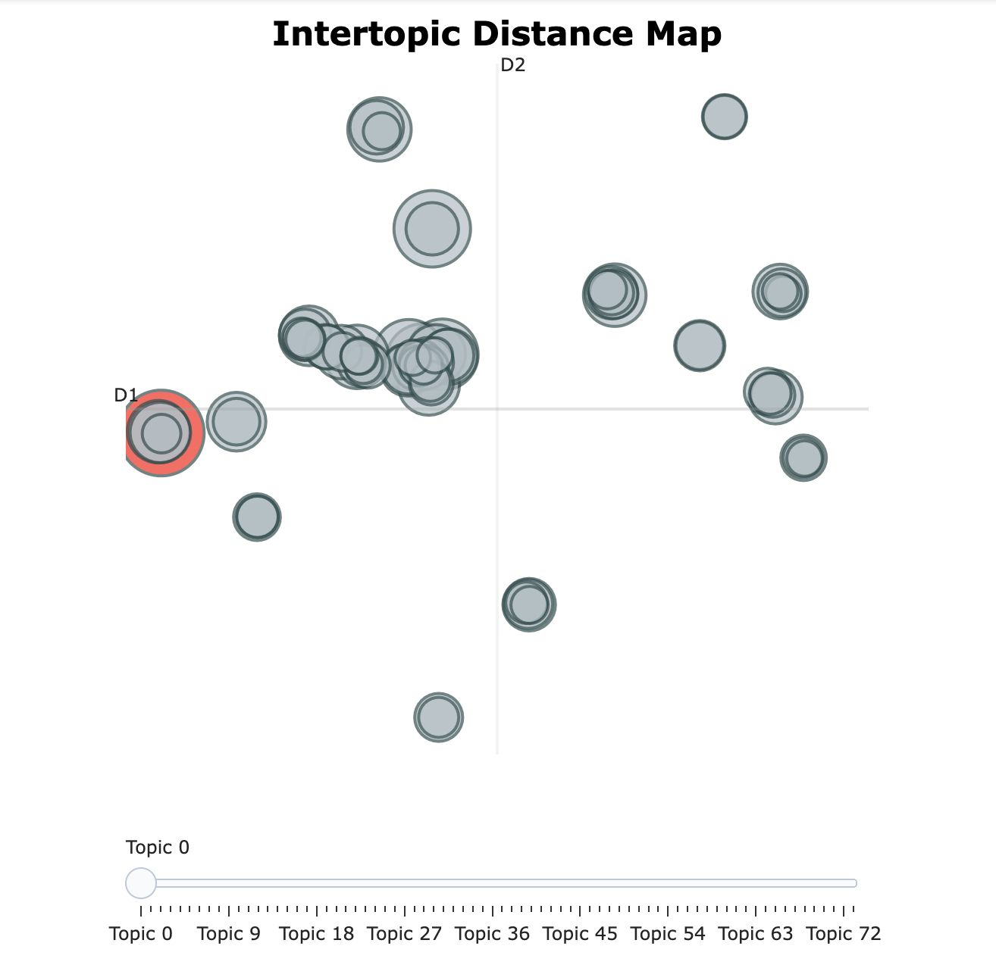
Part 7 Topic Modeling: What Do Ads Actually Say?
Interactive Semantic Layout

Slide 12
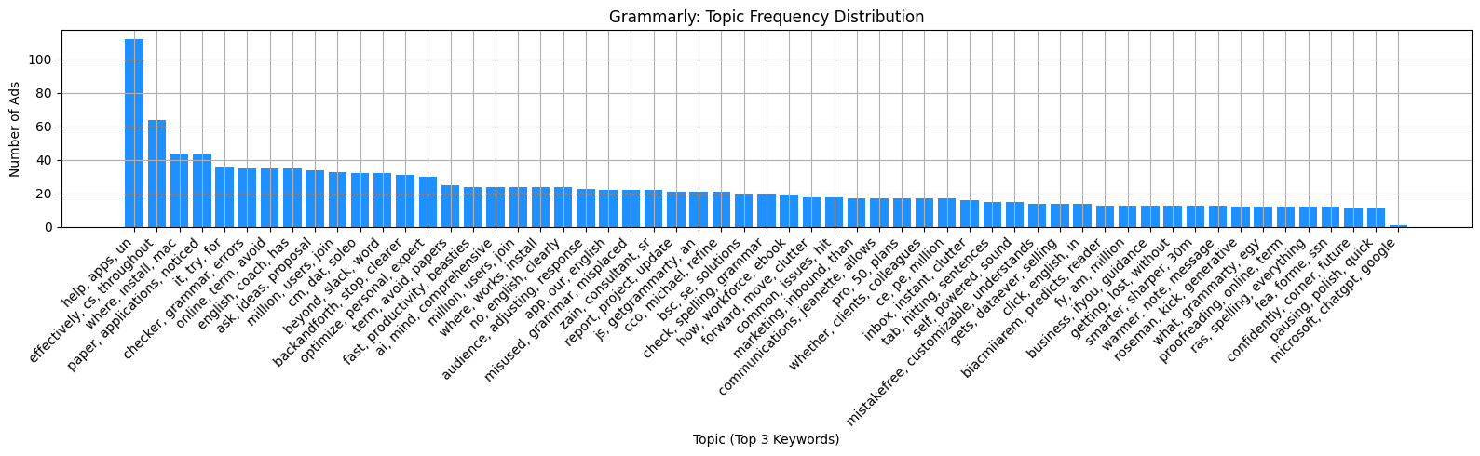
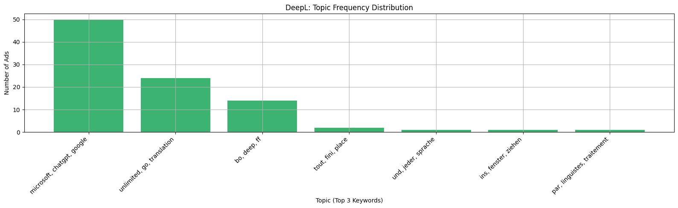
Grammarly spans more topics; DeepL concentrates on a few.
Topic spread mirrors semantic + visual patterns

Slide 13
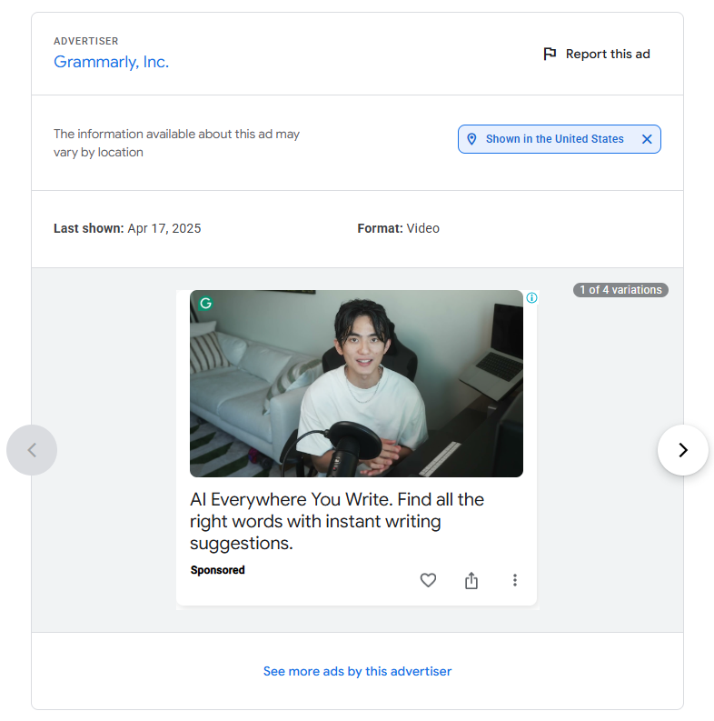
Challenge
Missing usable url for [‘format’]= “video”
Google Ads Transparency Center Website content is highly unscrapable

Slide 14
Open to Your Thoughts

